Slide 1

AI-Powered Medical Inventory Forecasting & Assistant
Project by: Supply Soul
Megha Narendra Simha, Poorrnima Vetrivelan, Nada Feteiha

Slide 2

AI-Powered Medical Inventory Forecasting & Assistant
Smart Stock Management | Demand Forecasting | Agent-Orchestrated Workflows
Team Supply Soul:
Megha Narendra Simha
Poorrnima Vetrivelan
Nada Feteiha

Slide 3

Problem Statement: Hospital Inventory Challenges
Stock-outs & Overstocking
Manual & Disconnected Systems
Delayed Approvals
Frequent stock-outs of critical medicines and wastage due to overstocking.
Slow procurement processes leading to operational inefficiencies.
Reliance on manual forecasting and fragmented inventory/demand systems.
Our solution automates and predicts medical inventory management using AI agents, addressing these critical issues.

Slide 4






Key Features of Our Solution
Multi-Agent Orchestrator
Semantic Search
Coordinated AI agents for efficient workflow management.
Accurate medicine name resolution for precise inventory tracking.
XGBoost Forecasting
Real-time Alerts
Advanced demand prediction for optimal stock levels.
Instant notifications for low stock, reorders, and out-of-stock situations.
Interactive Dashboard
Explainable Outputs
Visual insights with dynamic charts for comprehensive overview.
Clear explanations from each AI agent for transparency and Human in the Loop Check.

Slide 5

Our Robust Tech Stack
Backend Technologies
Frontend & Tools
Python (FastMCP)
React for dynamic user interfaces
XGBoost for predictive analytics
Chart.js for interactive data visualisation
PostgreSQL for scalable data storage
Tailwind / Custom CSS for styling
Sentence Transformers (Vector Embeddings)
Ngrok, GitHub, VS Code for development
Flask/NGROK bridge for connectivity
Igentic
OAuth & Gmail API

Slide 6
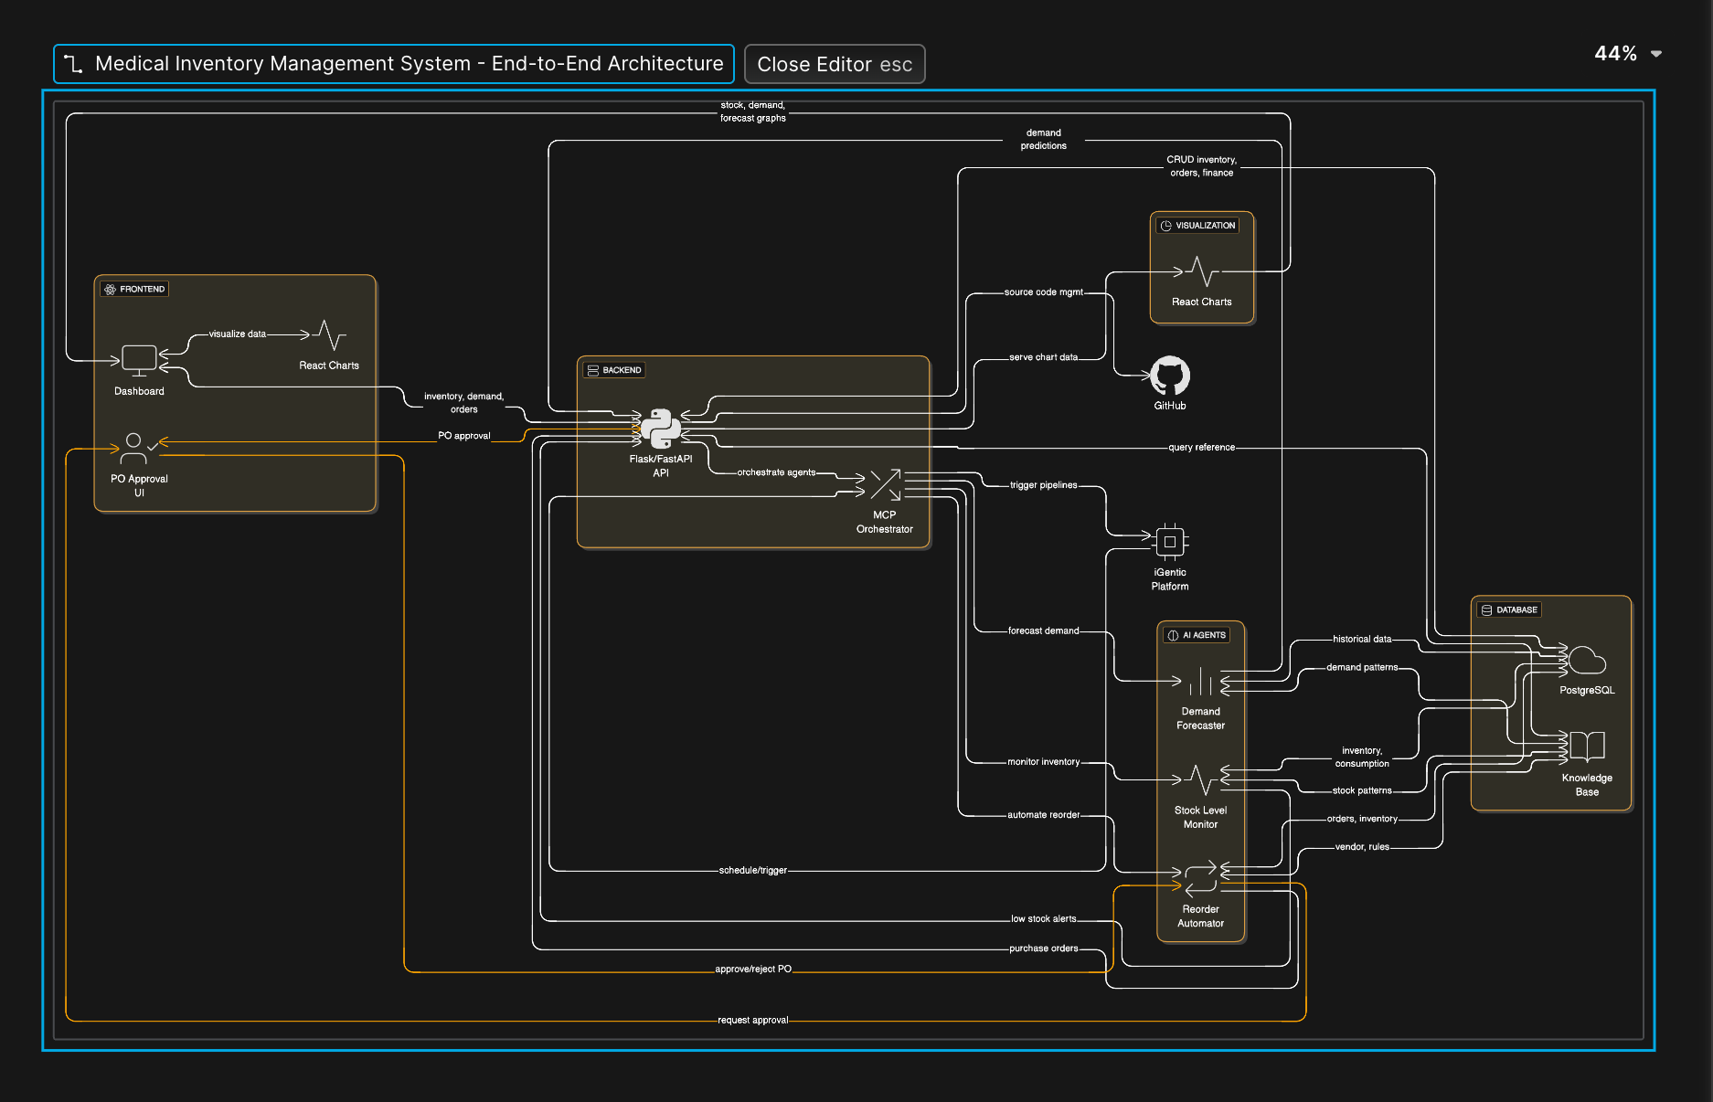





Architecture Overview
Our system processes user queries through a multi-stage architecture:
User Query
Initiates with a user request (e.g., Forecast, Stock, Alerts).
Orchestrator
Directs the query to the appropriate AI agent.
Data Retrieval
Agent fetches necessary data from PostgreSQL.
Processing
Semantic search resolves names; XGBoost models forecast demand.
Output & UI
Agents return structured output, updating the React UI dynamically.

Slide 7












Multi-Agent System Design
Our solution employs specialised AI agents, coordinated by a central orchestrator, to ensure comprehensive and efficient inventory management.
Greeter Agent
Stock Agent
Manages user interactions and provides a comprehensive dashboard view.
Monitors current inventory levels and identifies reorder requirements based on thresholds.
Email Agent
Reorder Agent
Sends automated notifications and alerts to procurement teams and stakeholders for critical inventory updates.
Manages procurement workflows, automating reorder processes, and communicating with suppliers.
Forecast Agent
Demand Agent
Performs predictive analytics using XGBoost models to forecast future demand.
Analyzes consumption patterns and semantic item matching to understand customer needs.

Slide 8
Data Pipeline: From Raw Data to Insights
01
02
03
Data Ingestion
Embedding Generation
Model Training
CSV files are loaded into PostgreSQL for inventory and demand history.
A vector database is built using 128-dimensional embeddings for semantic search.
XGBoost model is trained for accurate demand forecasting.
04
05
Real-time Queries
Visualisation
Agents process live queries to provide up-to-date information.
React UI renders dynamic charts and updated metrics for user insights.

Slide 9
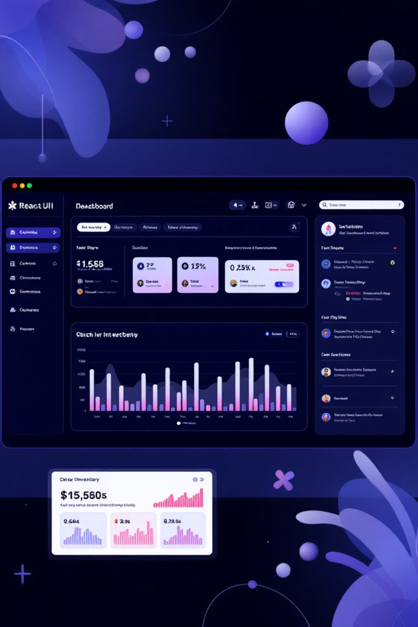
Frontend Features: Intuitive & Informative
Inventory Table: Detailed overview of all medical supplies.
Agent Conversation: Interactive interface for administrative tasks.
Real-Time Alerts: Notifications for low stock, out-of-stock, and expiring items.
Robust UI States: Comprehensive error handling and user feedback.
Dynamic Visuals: Bar, pie, and line charts for clear data representation.
Forecast Charts: Visual demand predictions using Chart.js.

Slide 10





Future Enhancements & Roadmap
Voice Alerts
Real-time SMS Alerts
Mobile App Integration
Critical stock situations trigger immediate voice alerts for staff.
Instant SMS notifications sent to staff and procurement teams for critical stock situations and urgent alerts.
Access inventory data and alerts on-the-go via a dedicated mobile app.
Advanced Analytics
Hospital System Integration
Comprehensive dashboard with deeper insights into inventory trends and forecasts.
Seamless connection with existing Hospital Management Systems (HMS).

